Slide 1



DNS and Web Domain Hosting Website
IGATE is now a part of Capgemini

Slide 2

TEAM MEMBERS
PRATIBHA BABAJI THOSAR
POOJAN SETHI
POOJA SHINDE
PARTH DOSHI
PALLAVI BAND

Slide 3
OVERVIEW OF THE PROJECT
Seiretto – Web Domain and Hosting
DNS : The Domain Name System(DNS) is the phonebook of the internet
Web Hosting : Web Hosting is a service that allows organizations and individuals to post a website or web page onto the internet.
Seiretto is a Web Hosting website that has a growing list of GOV.UK and AC.UK domains.
The website allows you to check for a particular domain name availability and buy the same.

Slide 4
ACTORS
User

Slide 5
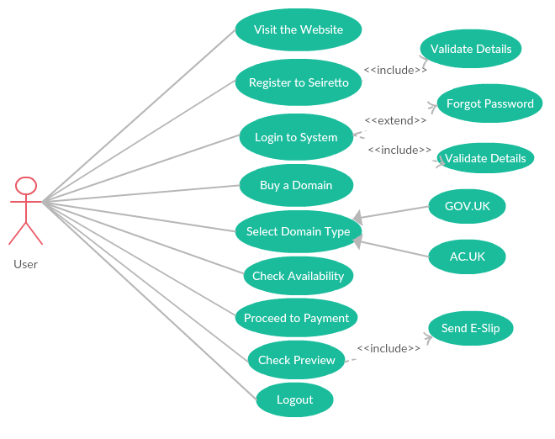
USE CASES
FLOW USE CASE:

Slide 6
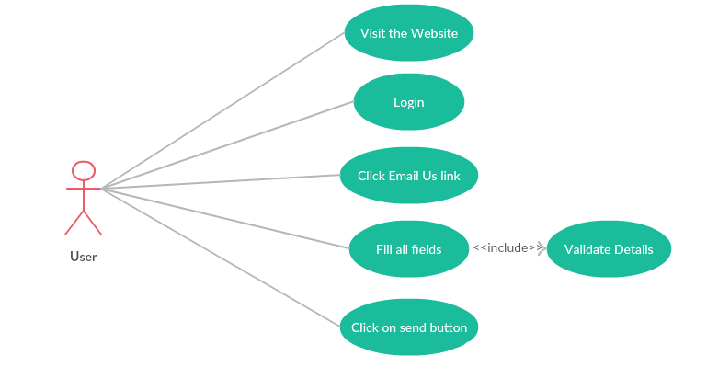
EMAIL USE CASE:

Slide 7
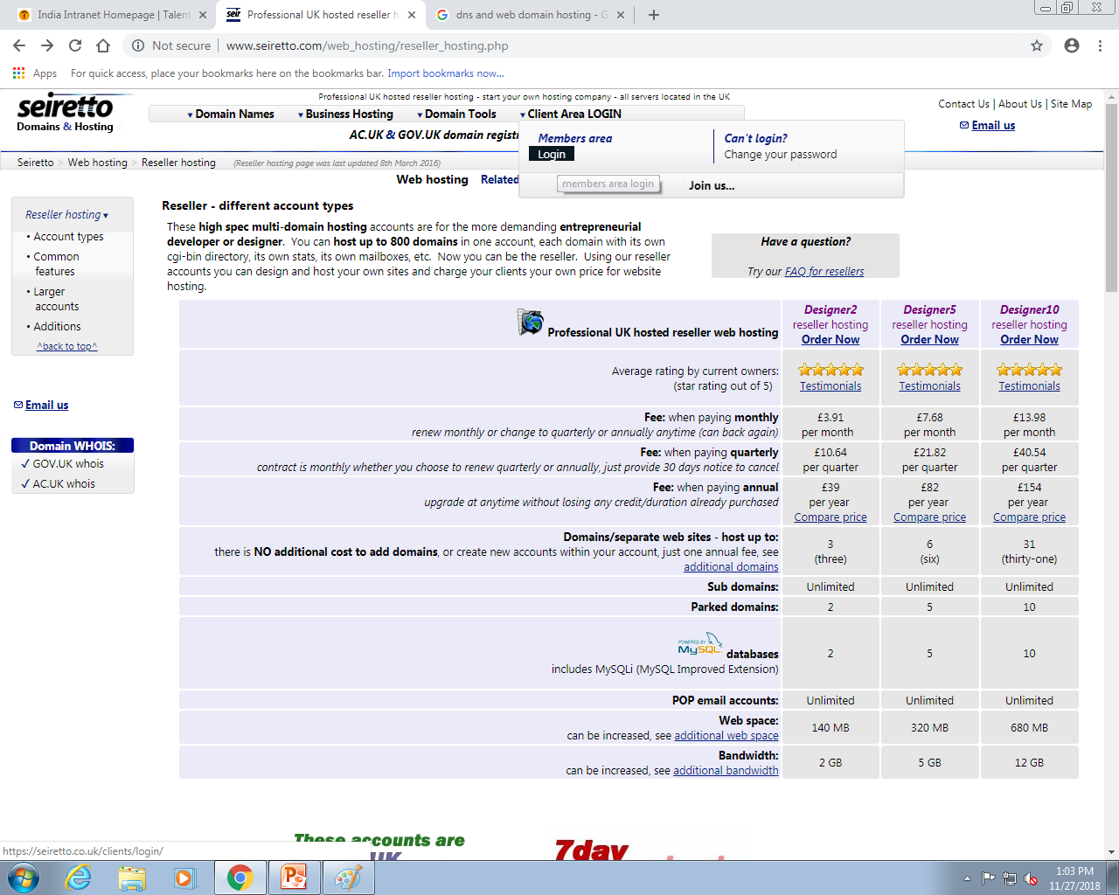
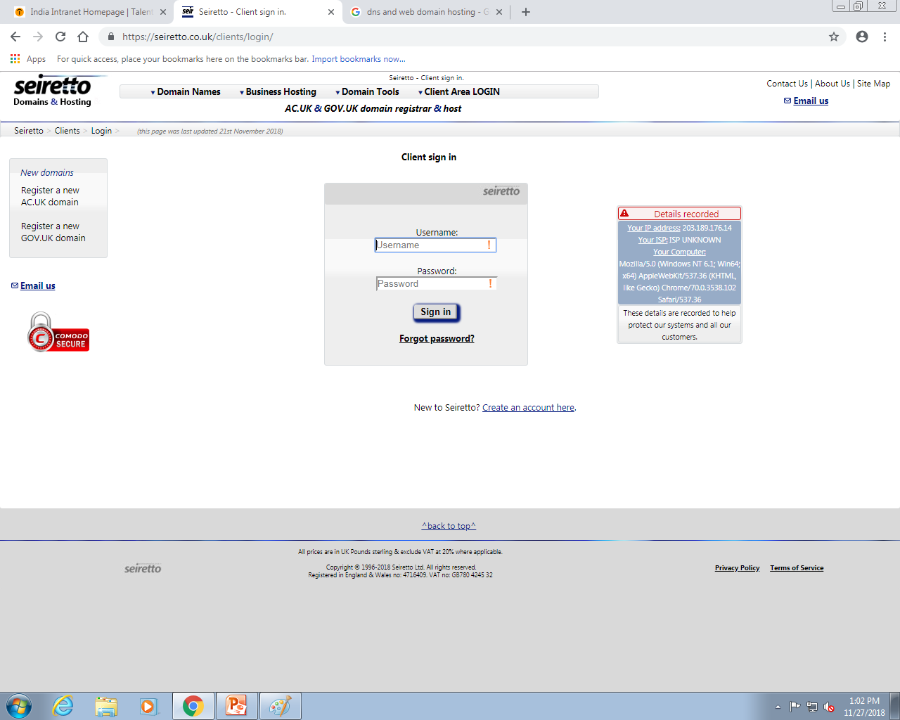
STEPS TO BUY A DOMAIN
1. REGISTER AND LOGIN:

Slide 8
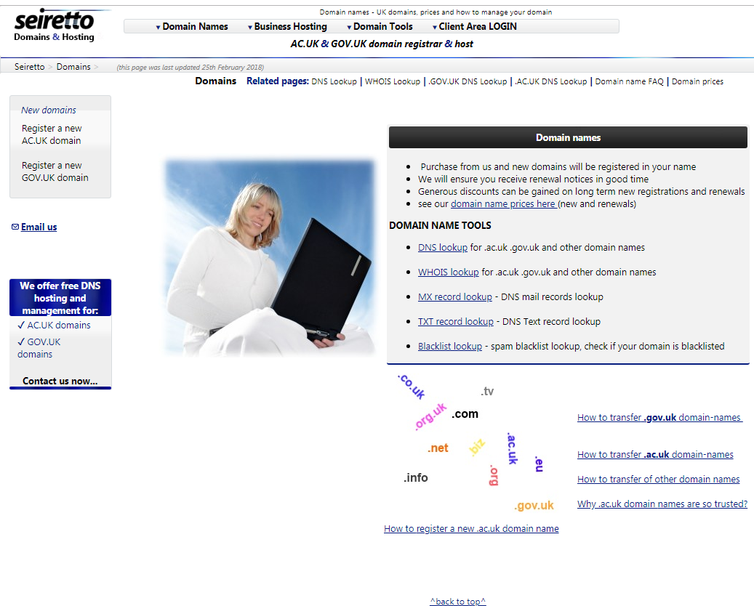
2. REGISTER FOR GOV.UK OR AC.UK DOMAIN

Slide 9
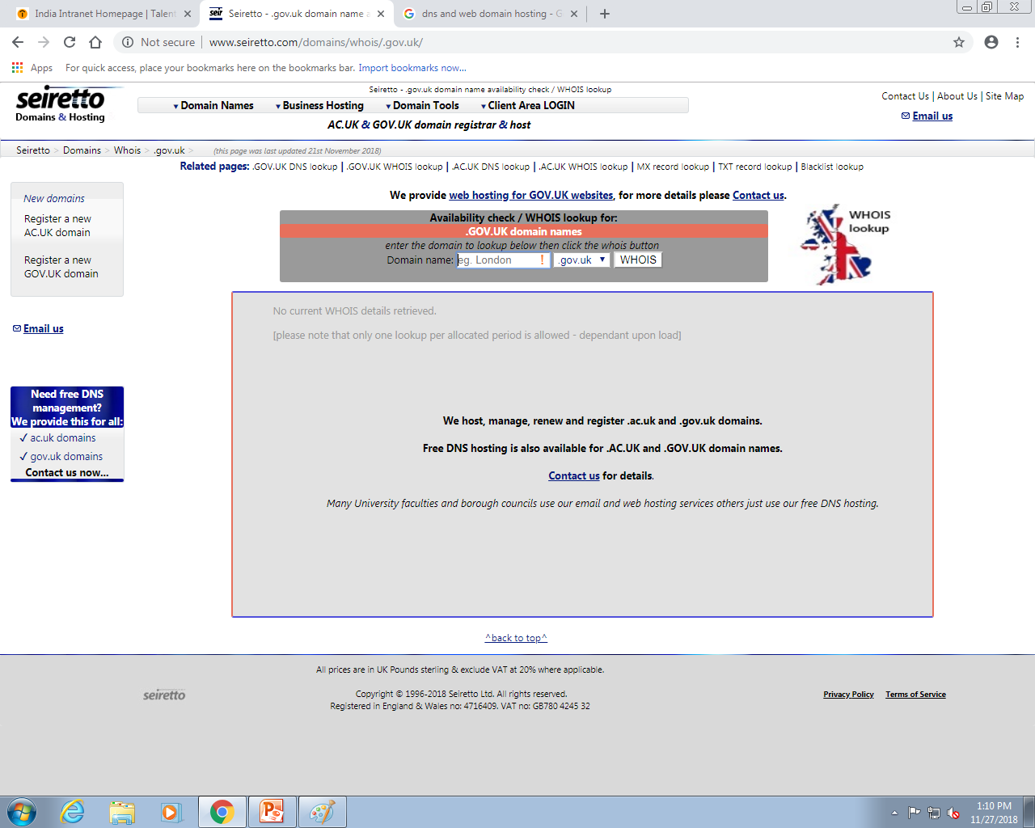
3. CHECK DOMAIN AVAILABILITY

Slide 10
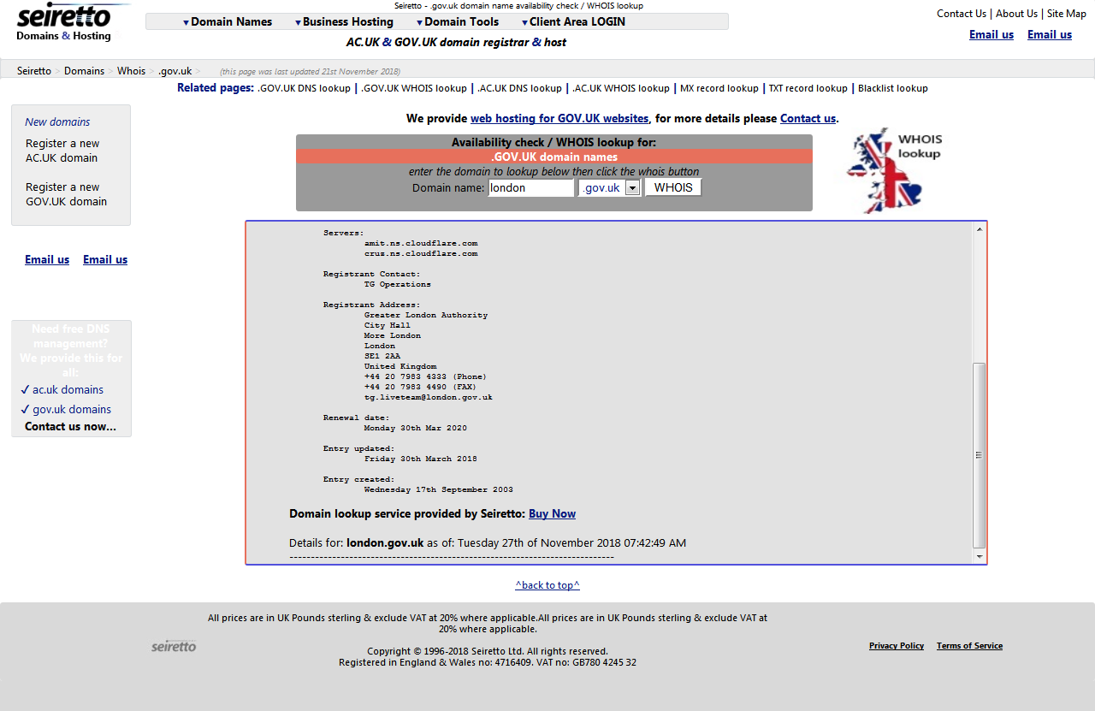
4. TO BUY DOMAIN WHEN IS IT AVAILABLE

Slide 11
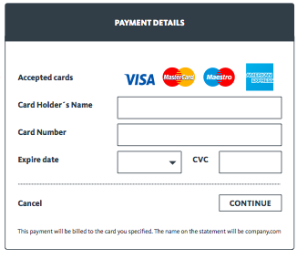
5. PAYMENT GATEWAY

Slide 12
TEST CASES
A TEST CASE is a set of conditions or variables under which a tester will determine whether a system under test satisfies requirements or works correctly.
There are four different type of test cases we have worked upon which are as follows :
Use Case Based
Inter System
State Transition
Security
Cause and Effect
The Link to our test cases of the application is : Test Cases.xlsx

Slide 13
DEFECT REPORT
DEFECT REPORT is a document that identifies and describes a defect detected by a tester. The purpose of a defect report is to state the problem as clearly as possible so that developers can replicate the defect easily and fix it.
The link to the defect report of our project is : Defect Report.xlsx

Slide 14
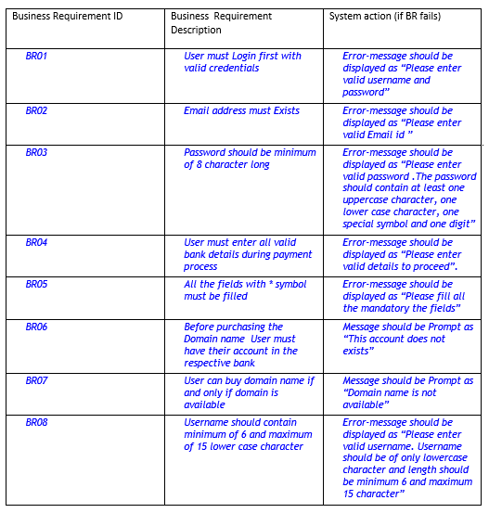
BUSINESS REQUIREMENTS

Slide 15
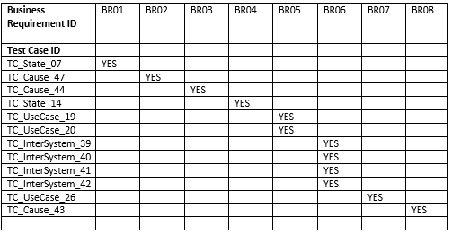
TRACEABILITY MATRIX
Requirements Traceability Matrix (RTM) is a document used to ensure that the requirements defined for a system are linked at every point during the verification process. It also ensures that they are duly tested with respect to test parameters and protocols.

Slide 16
Application link
http://www.seiretto.com/web_hosting/reseller_hosting.php

Slide 17
CONCLUSION
After going through the website, we got to see that a lot of modules are left incomplete and some of them are not functioning as desired.
The website needs to be more user friendly.
Login button should be displayed on every page.
Hence improvements are needed for the application to function as per the requirements.

Slide 18


